Slide 1

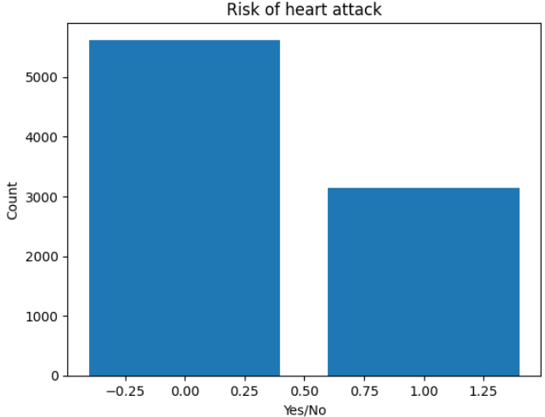
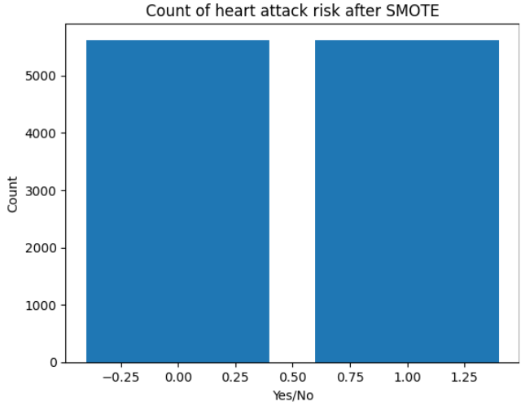
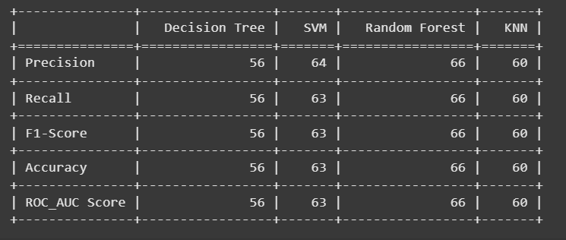
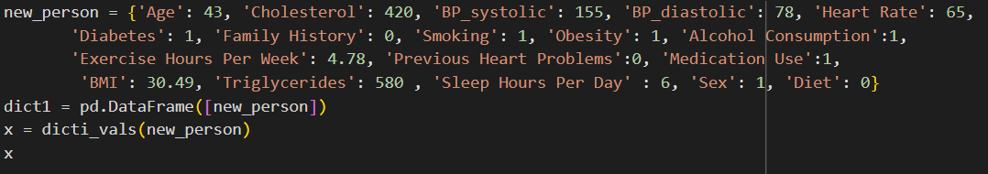
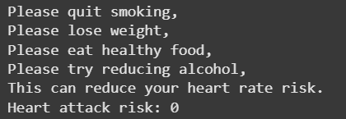
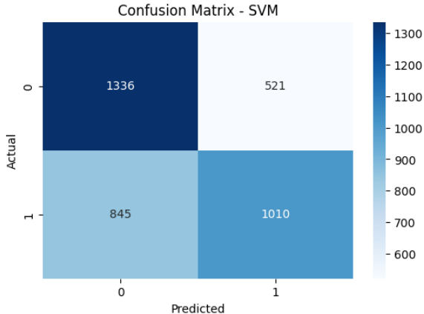
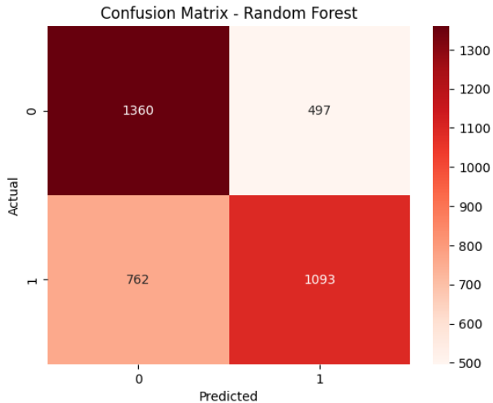
CVD Prediction Using Machine Learning
Student : Laxmi Sowjanya Doddi; Instructor : Yong Zhuang
Applied Computer Science
Abstract
The World Health Organization (WHO) reports that cardiovascular diseases (CVDs) are the leading global cause of death, accounting for approximately 17.9 million fatalities annually. CVDs encompass a range of disorders affecting the heart and blood vessels, including coronary heart disease, cerebrovascular disease, rheumatic heart disease, and other conditions. Over 80% of CVD-related deaths result from heart attacks and strokes, with one-third of these occurring prematurely in individuals under the age of 70..
This project focuses on analyzing the Heart Attack Prediction dataset available on GitHub. The dataset includes information on nearly 9,000 patients, featuring 25 attributes and a target variable. The objective is to develop a predictive model that assesses the likelihood of a heart attack by analyzing various factors such as income, stress levels, age, physical activity, and more.
Methodology
The dataset consists of clinical and physiological attributes of patients relevant to cardiovascular health. Each row represents a patient, and the goal is to predict whether the patient is at risk of Cardiovascular Disease (CVD) (target label: output or similar).
Key features include age, sex, cp(chest pain), blood pressure, cholesterol , stress level, exercise hours per week, income, country and so on. The target feature is “Heart Attack Risk” with the values of 0 represents “No Risk” and 1 represents “Risk”.
Data Preprocessing
Missing Values: Handled using imputation where necessary.
Normalization: Applied to scale numerical features for distance-based models like KNN and SVM.
Categorical Encoding: Encoded categorical features using one-hot or label encoding as needed.
Handling Class Imbalance
The target feature was imbalanced, with more samples in one class. To mitigate this:
SMOTE (Synthetic Minority Over-sampling Technique) was applied to the training set to synthetically generate new samples in the minority class, ensuring a more balanced class distribution for effective model training.
Machine Learning Models
We trained and compared the following models:
Decision Tree Classifier : A rule-based model that splits data by feature values.
Random Forest Classifier : An ensemble of decision trees that improves generalization and reduces overfitting.
Support Vector Machine (SVM) : A margin-based classifier effective in high-dimensional spaces.
K-Nearest Neighbors (KNN) : A distance-based classifier that considers the majority vote of k neighbors.
Model Evaluation & Optimization
To assess and compare model performance, we used:
Accuracy: Overall prediction correctness
Precision & Recall: To evaluate false positives and false negatives
F1 Score: Balance between precision and recall
ROC-AUC Score: For evaluating classification performance across thresholds
Hyperparameter tuning (e.g., grid search or randomized search) was performed to optimize each model for the best performance.
Results
Among the four machine learning models evaluated:
Random Forest outperformed all others with the highest scores across all metrics with 66% accuracy, indicating strong and balanced performance.
Testing the Model
The model is tested by passing the information of a person with the following values:
Output
Conclusion
Each record represents an individual's health, lifestyle, and demographic information aimed at predicting heart attack risk but only the health and lifestyle are highlighted as the top contributors .
Random Forest is the most effective model for predicting CVD risk in this case.
References
Adhikary D, Barman S, Ranjan R, Stone H. A Systematic Review of Major Cardiovascular Risk.
Notes:
Introduction Notes
When imagining the most important factors to take into account while designing drugs, affinity between the ligand and protein most likely comes to mind. However, another factor that should be considered almost as important as binding affinity is residence time. Residence time is how long a ligand stays bound to a protein and it is correlated with higher efficacy of the ligand. Drugs that have a longer residence time need less frequent doses administered, although longer residence times can lead to off-target toxicity.
Buried hydrophilic interactions between ligands and proteins increase residence time and larger ligands are more likely to have these interactions, hence the correlation between molecular weight and residence times. Methods for empirically testing residence time falls into two categories: labelled and unlabelled. An unlabelled example is surface plasmon resonance, which uses thermostabilized receptors, and requires purification and immobilization of the protein. Labelled methods, like indirect kinetic radioligand binding assays and bead-based methods, require a suitable labeled ligand and have limited throughput.
To bypass these limitations, molecular dynamics can be used to predict residence times in silica. Molecular dynamics have limitations of their own, though: calculating free binding energies must be run multiple times to get gaussian distribution, which is very computationally taxing. To mitigate this, the authors here attempted a method called ensemble-based steered atomistic molecular dynamics (SMD), which identifies relative binding forces to calculate relative residence time. To test ensemble-based SMD, the authors used a protein from the G protein-coupled receptor (GPCR) family, known as A_{2A}. These proteins are the largest membrane protein family in humans and are an important therapeutic target, despite being under-exploited in the drug market since the 1990s. The authors attempted to change this with their ensemble-based SMD method of residence-time prediction.
Method Notes
Step 1:
First, the authors needed to determine the boundaries for their simulation: time scale, velocity, and number of replicas. The authors decided on a time scale ranging from 40 ps to 10 ns by nothing that the initial pulling velocities ranged from 1 to 300 angstroms/ns. The authors found that the system was very sensitive to the rate of pulling, so more rapid rates required fixing every atom in the receptor. To avoid needing to fix every atom, they chose a pulling velocity of 1A/ns, which did not require immobilization of the entire receptor.
The authors noted that pulling had to cease in the simulation after the ligand started to reach the extracellular vestibule. This was decided because at this point, the pulling direction was no longer limited to a single directional vector due to the lack of constraints from the binding pocket.
To determine the number of replicas, the authors tried to encompass a wide range of ligand interactions by trying the simulations first with an agonist for the A2A protein (NECA), an antagonist (theophylline), and then the largest ligand in their dataset (UK-432,097). When performing replicas with these three ligands, they used a bootstrapping method, or random sampling replacement. They looked at the standard deviation from each bootstrap and found that it decreased as the replicas increased, steadying around 10 replicas.
Step 2:
To ensure results are valid to the real world situation, the receptor system must be valid. This is a membrane bound receptor and so the model should be bound to a membrane, hence the construction of the DPPC membrane in silica. The neutral charge was established using Na(+) and Cl(-) ions as counterions to bring the net charge of the model to zero. The wild type version of the protein was used, but this sequence had missing loops, so those loops were added to the structure using MODELER 9.12. For this model to function properly, thermostabilizing mutations in the protein had to be removed. These mutations originally biased the protein into staying in certain activity-defining physiological sates. To remove these mutations, UCSF’s Chimera 1.11.2 was used. Chimera's MatchMaker was used to superimpose ligand-binding positions taken from crystal structures into the equilibrated protein-membrane model.
Step 3:
Force fields for the simulation were determined using parameters from AMBER 14 and ligand parameterization was performed using the AM1-BCC charge model. The first stage of the simulation, where the protein is placed in the membrane and equilibrated, was performed at constant volume and constant temperature (NVT). After this first stage, the remainder of the simulation was performed at constant pressure and constant temperature (NPT), otherwise known as the Langevin piston method. The velocity of the atoms was chosen using a Maxwell-Boltzman, which was used to measure the distribution of gases in a thermoneutral environment. All simulations were performed with a time step of 2fs. In order to calculate the electrostatic interactions within this time period, the particle-mesh Ewald method was used. This method from theoretical physics applies well to systems under force by electrostatics.
The protein was given 6ns to equilibrate within the membrane. All elements were initially constrained except for water, but was the equilibration went on, the constraints were decreased to no constraints. A 10 ns SMD production run was carried out to move the ligands to the extracellular vestibule from the binding pockets. During the simulation, the protein was constrained to prevent drift in the direction of force, as the force applied to the ligand would cause the protein to move as well if not constrained.
Results Notes
Figure 1
The authors needed to determine whether the inactive or active state of the receptor will be used to carry out the protocol. Active and Inactive states were developed using A2A receptor from crystal structures. ZM-241,385 (inverse agonist) was then pulled from the active and inactive state of the receptor. The contact residues they found involved in residence were different between the inactive and the active state. This is important because in order to detect contacts, the receptor state should be matched to the properties of the ligand.
They also found a significant difference in PMF (Potential Mean Force) which is the average force over all configurations of the system. When ZM-241,385 was bound to the inactive state the PMF value was ~ 9 kcal/mol whereas when ZM-241, 385 was bound to the active state the PMF was ~ -25 kcal/mol. A negative PMF value means the ligand bound to the receptor is less energetically favorable than with it not bound. Therefore, ZM-241,385 prefers to be bound to the the inactive state rather than the active state. The inactive state was used to carry out the protocol.
Figure 2
For what defines an initial, intermediate and sustained contact see the first 6 bullet points of methods. Mutating the residues to an Alanine can increase/decrease residence time or binding infinity. Figure only displays dominate residues that are involved.
Initial
The author found five initial contacts involved with agonist only binding, three of them have previous experimental data.
Two new initial contacts to explore binding affinity and residence time.
Intermediate
13 intermediate contacts found
8 have previous experimental data
Sustained
5 sustained contacts found
Experimental data exist for 3 of these
2 contacts can be explored in more detail.
Figure 3
Residues interact with the ligand at different times of dissociation. The simulation timeline is colored dark gray and replica averages in light gray. Hydrogen bonds are shown with green solid lines and yellow ring. Pi-stacking bonds are shown with green dotted lines (bonds between aromatic rings) and purple ring. N253 makes a hydrogen bond initially (with NECA) - see blue arrow. Accept, LUF5967 and LUF5834 this is the same case for all other agonist and antagonist.
Figure 4
ΔE_{LW} is the change in interaction energy between water and the ligand. The figure shows pRT on the x axis which is the experimentally determined residence time for the 17 A2A ligands. As residence time increases ΔE_{LW} increases. This strong correlation suggests residence time depends highly on ligand-water interaction.
Conclusion Notes
This method of ensemble-based steered atomistic molecular dynamics can speed up in silica ligand dissociation, making it possible to identify transient and sustained residue interactions as well as calculate the water-ligand energy (ΔE_{LW}). The key to this method’s efficacy was using the interaction energies to predict the water-ligand energy, rather than simulating the entire dissociation in silica. Deciding whether to use the active or inactive receptor state is crucial for successful prediction of the transient residue contacts.
The authors found that water-ligand energy was the most important factor for determining residence time as the two had a correlation of R² = 0.79. The advantages of this method included: using interaction energies rather than dissociation times to predict water-ligand energy; being less computationally expensive than RAMD; and having the same computational cost for different ligands of the same receptor protein.
The experiment was performed with 17 ligands for the A_{2A} receptor, a well-characterized GPCR with a lot of kinetic binding data available, but it could be used for other receptor-ligand complexes that have binding pockets exposed to water and well-resolved structures available. Based on the findings from this experiment, the authors recommend future drugs for the A2A protein to include an aromatic ring extension, as ligands with this extension showed an increased residence time in their experiments. Ensemble-based SMD proved to be more informative and less computationally challenging than similar methods and is a promising tactic for future experiments.

